Slide 1
Era 4
By Zachuary Veilleux and Steven Hargreaves

Slide 2
We both made different forms of art, different topics, and two different resources. I drew pictures of animals and nature. I was inspired by Andy Warhol and Zach was inspired by Ferdinando Tacconi. I was inspired by Andy Warhol because he painted pictures of animals and when I saw a painting of a butterfly by him that inspired me to draw one. Like I said Zach and I both drew very different things with very different resources. For example, I drew an animal with a pencil and color pencils and Zach made a plane out of cardboard and then took a photo.

Slide 3
Ferdinando Tacconi was an Italian painter who liked to paint and draw themes of war and of war times in Italy. He also created a painting that caught my interest as I knew I wanted to do something involving the plane’s first flight. I recreated Tacconi’s painting with a photograph because I was confident in my photography skills and it’s a medium I enjoy exploring. I made a plane with cardboard, toothpicks, and hot glue. I then threw the plane in the air and I had to take the picture quickly because it fell out of the sky swiftly. It took me several tries to get the final picture but eventually, I got it. I’m really proud of what I created. I knew when recreating it in minecraft i had to get it as accurately portrayed as i could.

Slide 4
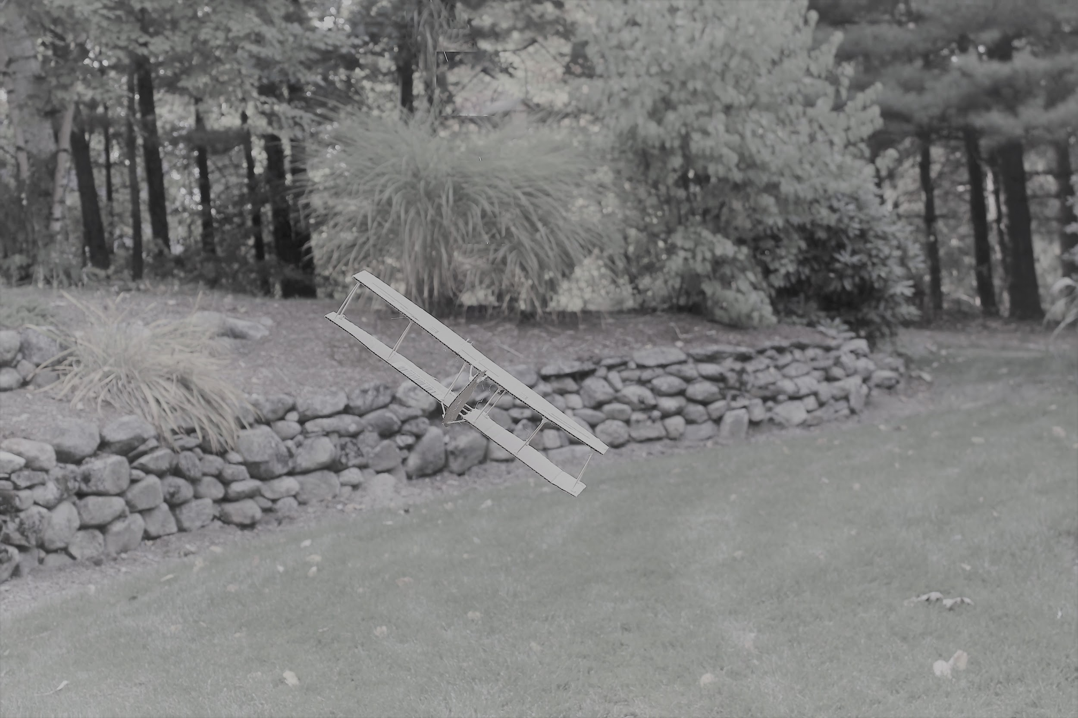
Before

Slide 5
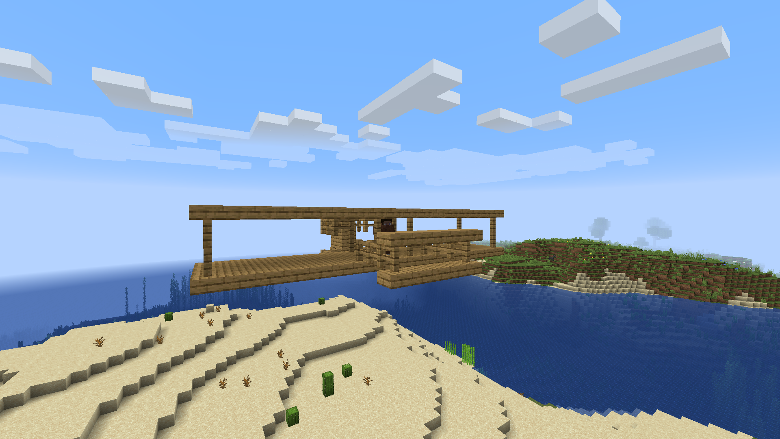
After

Slide 6
We created a replica of what Zach made in his original exhibition piece in the game Minecraft. Zach was inspired by Ferdinando Tacconi and he had a lot of firsts when it came to art. When we were about to make the airplane in Minecraft we had to first we visualised the picture and then started building. It only took about 40 minutes to build with some revisions on the airplane but we both think it turned out good in the end.

